Slide 1
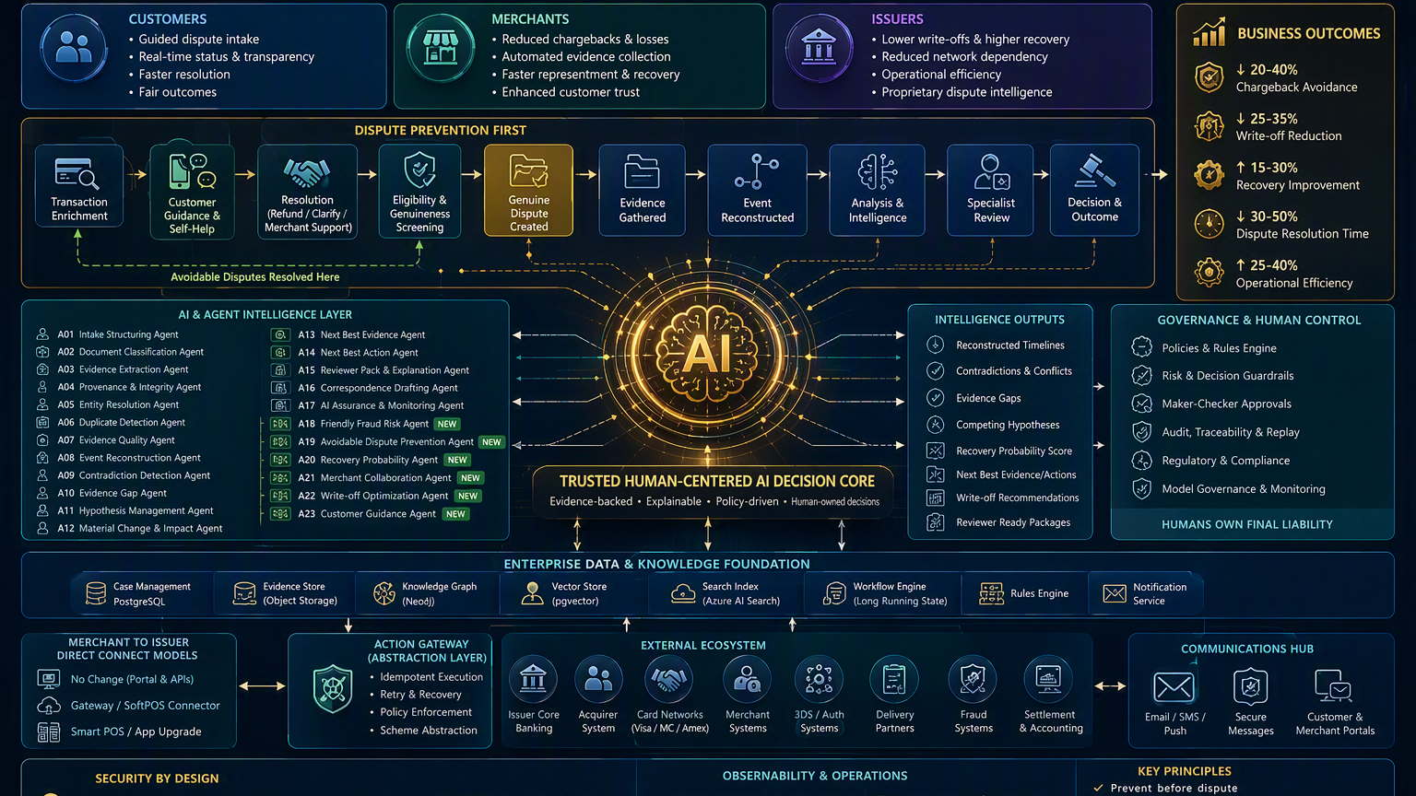
DISPUTE
INTELLIGENCE
FABRIC 2.0
Prevent • Resolve • Recover
Evidence-backed AI, human-owned decisions, lower losses and better experiences for every participant.
25-minute jury story
BFSI-ready
Domain-agnostic core
Notes:
Opening: Frame the idea as a shift from downstream dispute processing to prevention, intelligence and recovery. Emphasize that AI assists; humans own liability and consequential actions. [Sources] - Visual on this slide was generated with Microsoft Copilot.

Slide 2
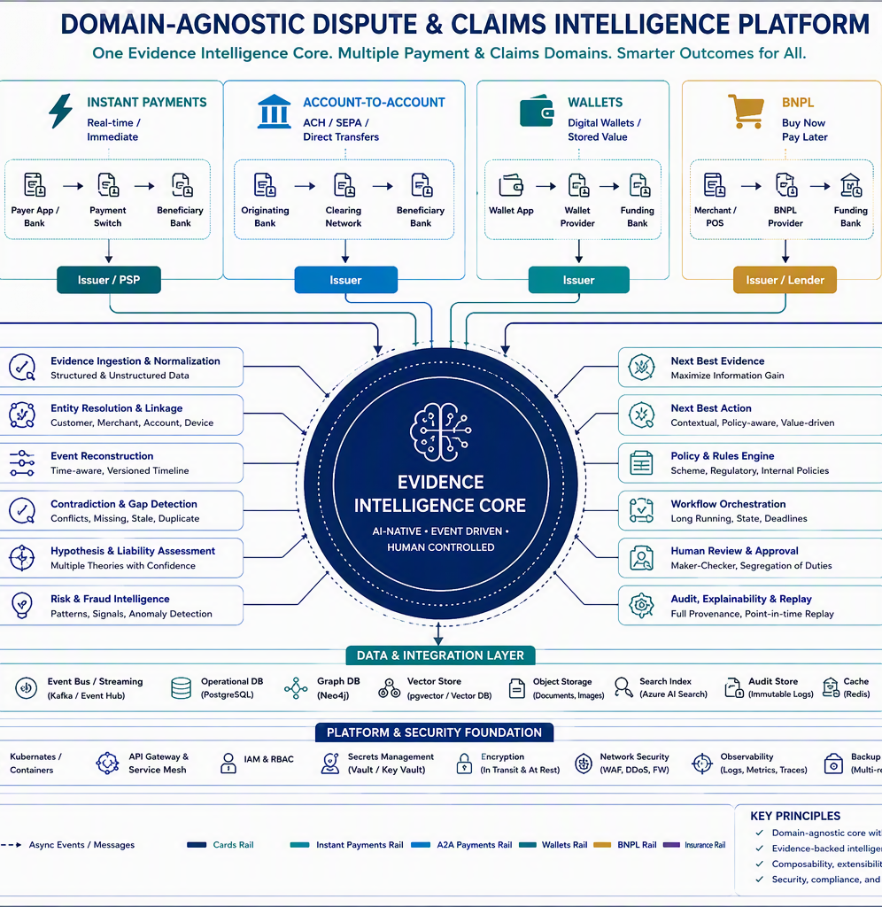
Our understanding of the business problem
Disputes are not forms to process. They are long-running, evidence-intensive decisions under deadlines.
Fragmented evidence
Reactive operations
Customer, merchant, transaction, delivery, authentication and network records arrive at different times.
Teams reconstruct the story manually after a dispute is already costly.
Leakage and write-offs
Poor experience
Weak evidence, missed deadlines and poor prioritization turn recoverable cases into losses.
Customers repeat information, merchants assemble evidence manually, issuers face long cycle times.
The structural issue
The current model optimizes the dispute lifecycle after it starts. The opportunity is to prevent avoidable disputes, collaborate earlier and make every genuine case evidence-ready.
Notes:
Spend about 90 seconds. Explain the four structural problems. Avoid blaming customers or merchants. The issue is fragmented context, late intervention and rigid workflows. [Sources] - Source: Dispute Intelligence Fabric Solution Blueprint 2.0. - Source: TCS dispute process assets summarized in the internal solution documents. - Visual on this slide was generated with Microsoft Copilot.

Slide 3
The ambition: move from “process a dispute” to “prevent, understand and recover”
1
2
3
4
5
PREVENT
COLLABORATE
UNDERSTAND
RECOVER
GOVERN
Clarify the transaction and resolve avoidable issues before case creation.
Exchange evidence with merchants before escalation where permitted.
Reconstruct events, expose conflicts and retain uncertainty.
Prioritize recoverable work and strengthen evidence packages.
Keep policy, approvals, external actions and final liability under human control.
North star: Evidence → Intelligence → Human Decision → Controlled Execution
Notes:
Use this as the central narrative. Each pillar becomes a design principle and a measurable business outcome. [Sources] - Source: Solution Blueprint 2.0.

Slide 4
Solution in one view
Five capabilities work as one prevention-to-recovery fabric.
1
2
3
4
5
Guided intake
Evidence intelligence
Merchant collaboration
Recovery optimization
Human control
Transaction enrichment, merchant recognition, refund and delivery visibility.
Immutable evidence, provenance, timeline, contradictions, gaps and hypotheses.
Portal/API evidence exchange and pre-chargeback resolution.
Recovery probability, next-best evidence/action and write-off recommendations.
Policy, maker-checker, idempotent actions, audit and point-in-time replay.
Notes:
A concise architecture-to-business bridge. Show that the differentiator is the combination, not only the agents. [Sources] - Source: Solution Blueprint 2.0. - Source: Executive Value Proposition 2.0.

Slide 5
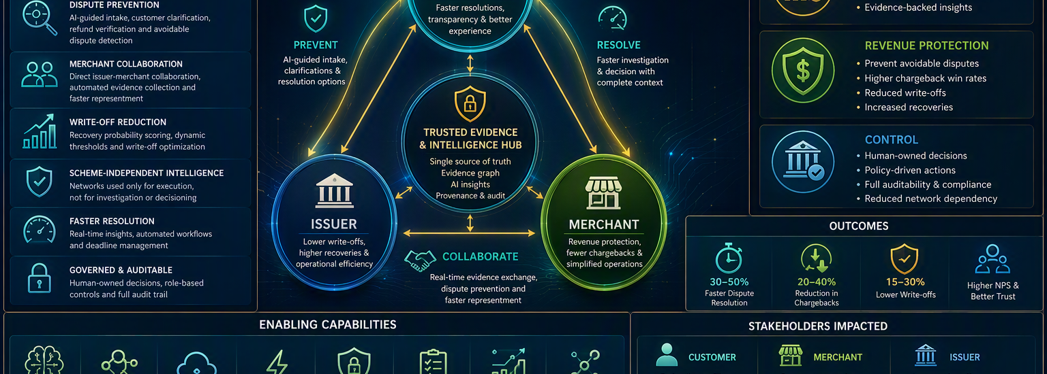
Future-state journey: intervene earlier, decide better
Genuine cases continue; avoidable issues are resolved before formal dispute creation.
1
2
3
4
5
6
7
8
9
10
Clarify
Guide
Screen
Create
Gather
Reconstruct
Compare
Recommend
Approve
Execute
Avoidable issues resolved here
Humans own liability
Notes:
Explain the journey in two halves. First, prevent unnecessary disputes without suppressing genuine rights. Second, make genuine disputes evidence-ready and controlled. [Sources] - Source: Future-State Process and Swimlane Specification 2.0. - Visual on this slide was generated with Microsoft Copilot.

Slide 6
Why this is differentiated
Not another case-management front end, and not autonomous adjudication.
Prevention before processing
Evidence graph, not document pile
Transaction clarification and guided resolution are first-class capabilities.
Assertions, provenance, dependencies and bitemporal timelines make reasoning traceable.
Targeted re-evaluation
Institution-owned intelligence
Late evidence invalidates only affected outputs, recommendations and approvals.
Networks are used for execution and interoperability, not outsourced investigation.
Human-centered AI controls
Domain-agnostic evidence core
Agents classify, compare, rank and draft; rules and people own consequential outcomes.
Common intelligence patterns extend beyond cards to other payment and claims domains.
Notes:
This is the jury differentiation slide. Pause on targeted re-evaluation and human-control boundaries. [Sources] - Source: Solution Blueprint 2.0. - Source: AI and Agent Architecture 2.0. - Source: Network Independence Strategy 2.0.

Slide 7
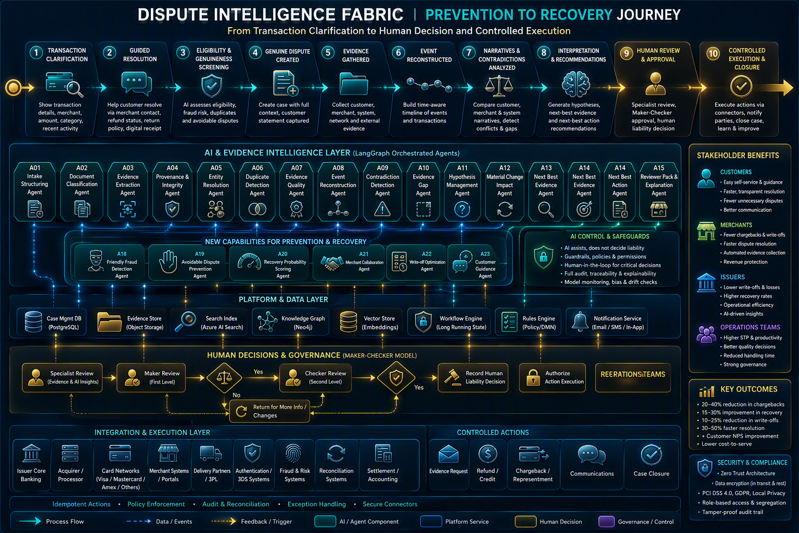
End-to-end solution architecture
A composable platform with bounded AI, deterministic controls and scheme-agnostic connectors.
Read top to bottom: stakeholder experiences → intake and case services → AI intelligence → data and integration → secure operations
Notes:
Use two minutes. Give the audience the map, not every box. The next slides explain the layers. [Sources] - Source: Solution Blueprint 2.0. - Source: AI and Agent Architecture 2.0. - Visual on this slide was generated with Microsoft Copilot.

Slide 8
Layers 1–3: experience, business services and policy control
1. Omnichannel experience
2. Case & workflow services
3. Deterministic decision services
Customer self-service and guided intake
Merchant portal for collaboration
Investigator, specialist and approver workspaces
Operations, audit and governance dashboards
Case lifecycle and tasks
Evidence and communication services
Approvals and controlled actions
Deadlines, retries and long waits
API-first experience composition
Eligibility and duplicate rules
Scheme, market and jurisdiction policy
Authority and maker-checker controls
Idempotent action gateway
Human-liability record
Notes:
Explain separation of experience, durable workflow and deterministic decisions. This prevents AI from becoming the system of authority. [Sources] - Source: Solution Blueprint 2.0. - Source: AI Control and Human Decision Matrix.

Slide 9
Layer 4: bounded AI and agent orchestration
Agents are specialized workers around a governed case state, not autonomous judges.
A01–A07
A08–A12
A13–A17
A18–A23
Intake & evidence
Reasoning
Work assistance
Prevention & recovery
Structure, classify, extract, validate provenance, resolve entities, detect duplicates and assess quality.
Reconstruct events, detect contradictions, identify gaps, maintain hypotheses and assess material change.
Recommend evidence/actions, prepare reviewer packs, draft correspondence and monitor AI assurance.
Flag clarification needs, prevent avoidable disputes, score recoverability, collaborate with merchants, optimize write-offs and guide customers.
Hard boundary: no agent rejects a genuine case, declares fraud, decides liability or executes a consequential external action.
Notes:
Explain why specialization matters: bounded context, smaller prompts, clearer evaluation and safer fallback. [Sources] - Source: AI and Agent Architecture 2.0.

Slide 10
Layers 5–7: data, integration and secure operations
Evidence & knowledge
Event & integration
Platform & operations
PostgreSQL case state
Object evidence store
Knowledge graph
Search + vector retrieval
Immutable audit store
Kafka/Event Hub
Schema registry
Dead-letter + replay
Merchant and POS adapters
Scheme/action adapters
Kubernetes scaling
Secrets and keys
Observability and SRE
CI/CD and policy-as-code
FinOps and model monitoring
Notes:
Emphasize event-driven decoupling and the distinction between operational database, evidence object store, graph and retrieval indexes. [Sources] - Source: Solution Blueprint 2.0. - Source: API and Integration Change Specification 2.0.

Slide 11
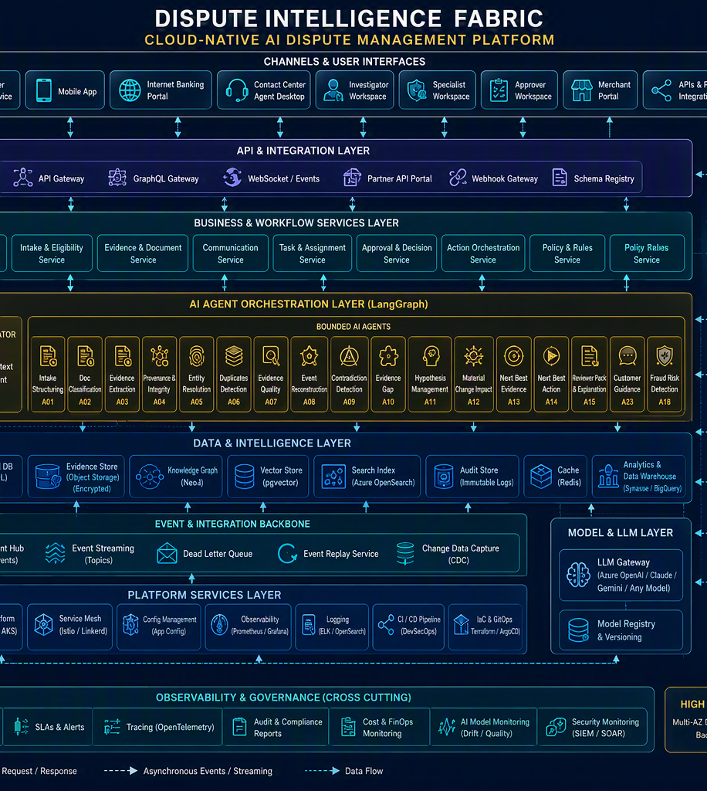
NFR focus: scalability, resilience and performance
Scale the hot path independently while keeping expensive reasoning asynchronous.
Elastic services
Partitioned events
Stateless APIs and independently scalable workers.
Case-keyed streams preserve order while scaling throughput.
Async heavy work
Durable recovery
OCR, extraction and agent reasoning are off the interactive path.
Retries, idempotency, status inquiry and reconciliation.
Selective refresh
Degraded modes
Material change re-runs only impacted analysis.
Human-only and rules-only operations when models or tools are unavailable.
Notes:
Focus on how scalability is achieved, not by one large cluster but by separating interactive, asynchronous, storage and integration workloads. [Sources] - Source: Executive Value Proposition 2.0. - Visual on this slide was generated with Microsoft Copilot.

Slide 12
NFR focus: cost efficiency and speed
Costs fall when we prevent work, automate evidence and spend intelligence only where value exists.
Prevent work
Reduce manual touches
Use bounded models
Clarify descriptors, refunds and delivery status before cases are created.
Auto-classify, extract, reconcile and assemble reviewer-ready packs.
Shorter context, model routing, caching and human-only fallback control AI spend.
Prioritize recoverability
Avoid duplicate actions
Accelerate decisions
Focus specialist effort on cases with useful evidence and viable deadlines.
Idempotency and reconciliation prevent repeated postings and scheme submissions.
Parallel analysis and proactive evidence requests reduce waiting and rework.
Measure against a baseline: cost per case • AI cost per resolved case • manual touches • avoided disputes • recovery value • cycle time
Notes:
Avoid promising unvalidated percentages. Present these as measurable levers and propose a baseline-led pilot. [Sources] - Source: Executive Value Proposition 2.0. - Source: Write-Off Reduction and Genuine Dispute Prevention Strategy.

Slide 13
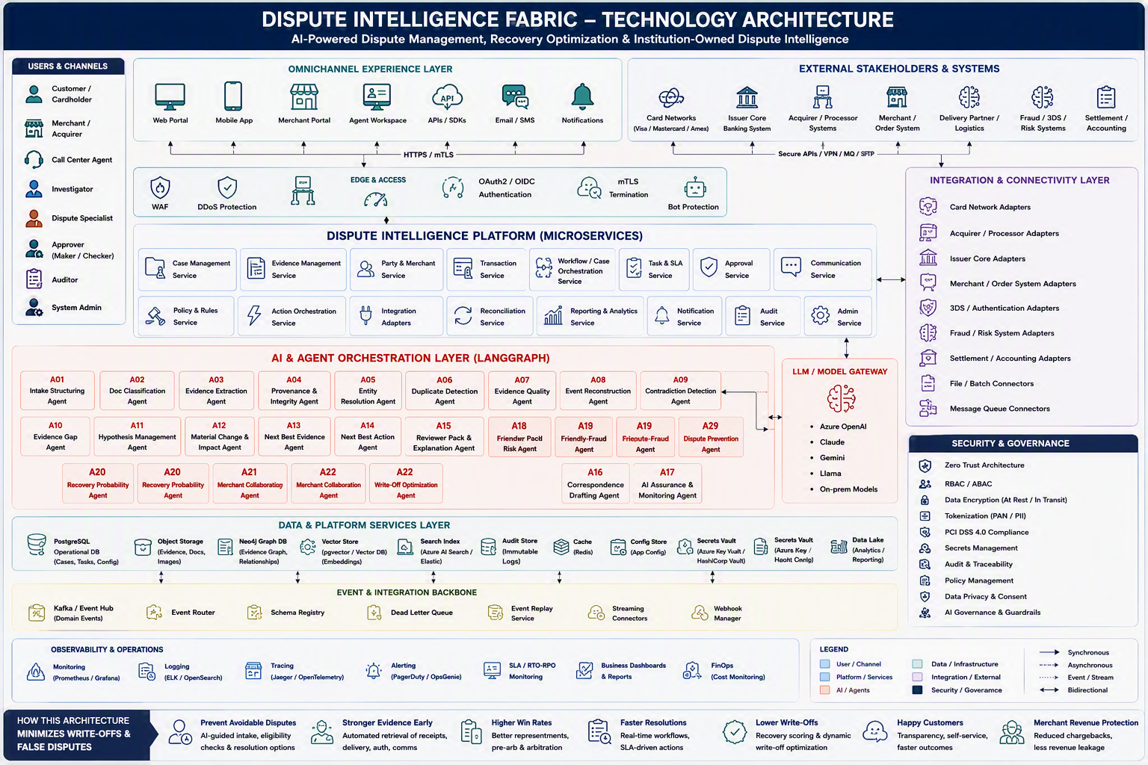
Domain-agnostic by design
The intelligence core is common; policies, evidence types and execution rails are configurable.
Shared core: evidence • events • contradictions • gaps • hypotheses • workflow • human review • audit
Notes:
Domain agnostic does not mean generic outcomes. The reusable core is combined with domain-specific policy packs, schemas, connectors and human authority. [Sources] - Source: Solution Blueprint 2.0. - Source: Network Independence Strategy 2.0. - Visual on this slide was generated with Microsoft Copilot.

Slide 14
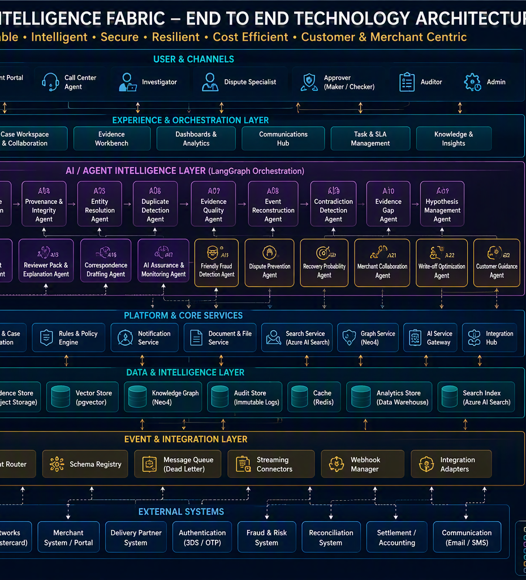
One platform, aligned value for every stakeholder
Customer
Issuer
Clearer transactions, fewer accidental disputes, faster genuine-case resolution and transparent status.
Lower write-offs, stronger recovery, lower operational cost and institution-owned intelligence.
TRUSTED
EVIDENCE
CORE
Merchant
Operations & control
Lower chargeback leakage, automated evidence, faster response and better revenue protection.
Prioritized work, fewer missed deadlines, clear approvals, audit replay and safer AI controls.
Value alignment reduces friction: better context for the customer, less evidence effort for the merchant and stronger control for the issuer.
Notes:
Bring the story back to people and economics. Stress that merchant adoption is value-led, not a technology mandate. [Sources] - Source: Executive Value Proposition 2.0. - Source: Merchant and POS Adoption Business Case 2.0. - Visual on this slide was generated with Microsoft Copilot.

Slide 15
Pragmatic adoption roadmap
Prove value without forcing a full POS or network transformation on day one.
1
2
3
4
Foundation pilot
Merchant collaboration
Scale & optimize
Cross-domain expansion
Guided intake
Evidence intelligence
Existing issuer integrations
Baseline KPIs
Merchant portal
API evidence exchange
Pre-chargeback resolution
Recovery assessment
Gateway/POS software options
Scheme adapters
Multi-market policy packs
FinOps and AI assurance
Instant payments
A2A and wallets
BNPL and claims patterns
Shared intelligence core
Prove fewer avoidable cases and faster specialist readiness.
Increase evidence completeness and revenue recovery.
Scale throughput and reduce unit cost.
Reuse the platform beyond cards.
Notes:
Close the feasibility concern. Start with guided intake and evidence intelligence; add POS/gateway change only after the value case is proven. [Sources] - Source: Merchant and POS Adoption Business Case 2.0. - Source: Solution Blueprint 2.0.

Slide 16
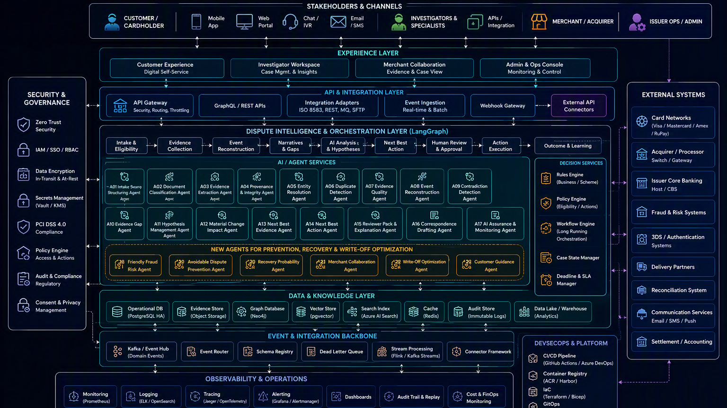
Our proposal
Turn disputes into
institution-owned intelligence
Why this deserves to win
✓
Business outcome-led, not AI-led
✓
Architecturally feasible and incrementally adoptable
Prevent what should not become a case.
Resolve genuine cases with stronger evidence.
Recover value before write-off.
Keep humans in control.
✓
Differentiated by prevention + evidence graph + recovery
✓
Scalable, domain-agnostic and cost-aware
✓
Human-owned, auditable and regulator-ready
Thank you • Questions
Notes:
Final close in 45 seconds. Repeat the four verbs: prevent, resolve, recover, govern. Then invite questions. [Sources] - Visual on this slide was generated with Microsoft Copilot.

